Slide 1
Classifying Organisms
Teach Well

Slide 2
Students will use scientific names to identify species.
Yr 7:
Classification helps organise the diverse group of organisms (ACSSU111)

Slide 3
Do not delete this slide.
It is hidden from your show.
You can use this page to copy and paste the relevant prompt boxes into your presentation
CFU
Vocabulary
Extension

Slide 6
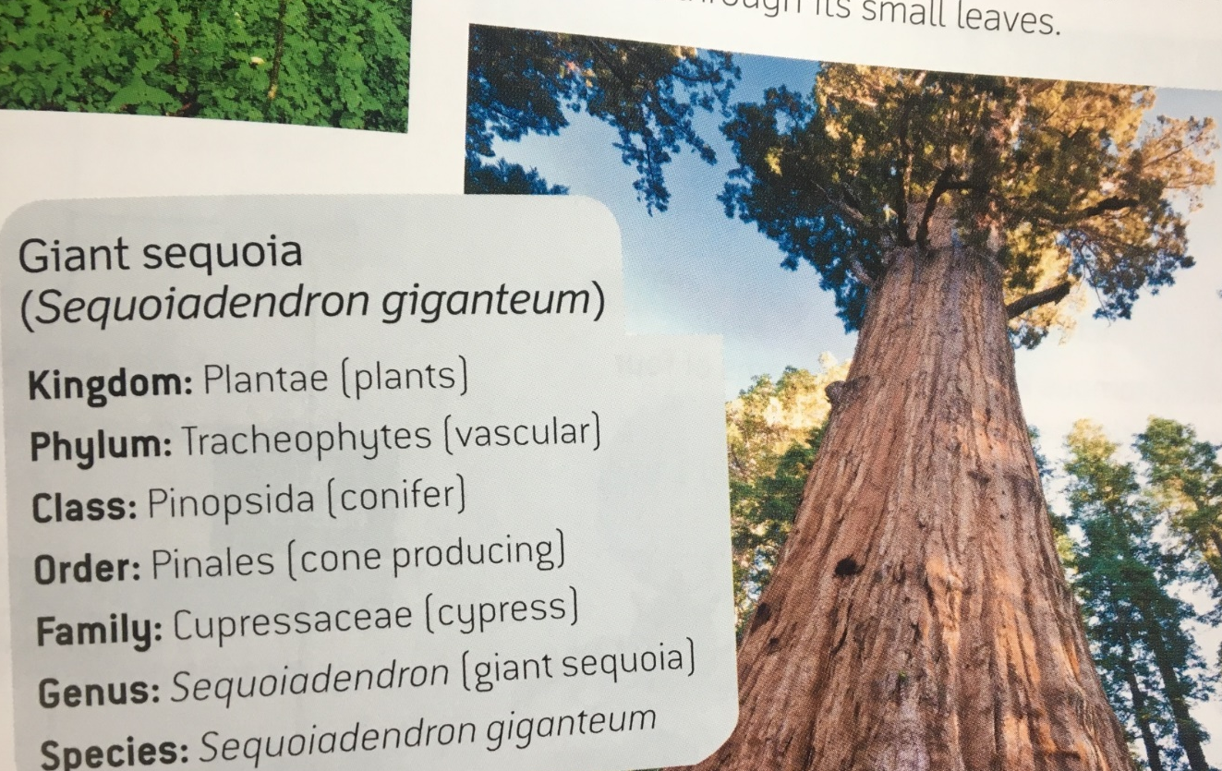
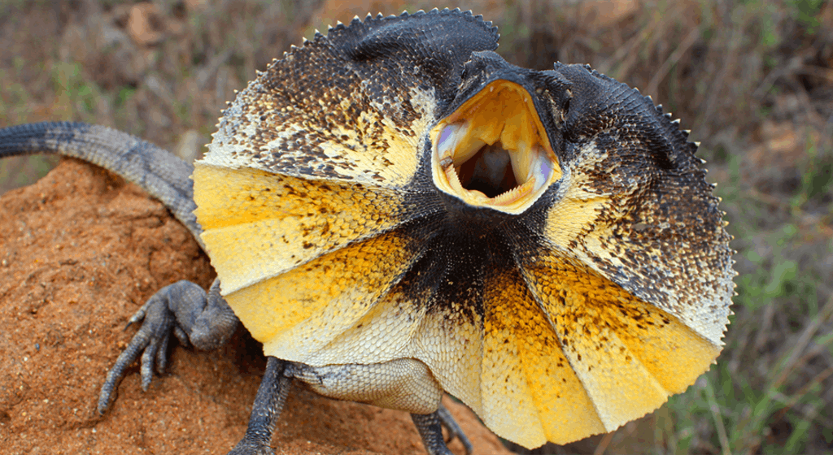
Students will use scientific names
to identify species.
Vocabulary
Identify = pick out
CFU
What are we learning today (own words)?
Write the scientific names
for these organisms:
Notes:
Read through L.O.
CFU – Think - Pair –Share. Have students tell their partners, in their own words, what they will be doing in today’s lesson, then call on non-volunteers to tell you the objective in their own words.
Read over the success criteria, explaining that by the end of the lesson they should be able to confidently complete the task independently.

Slide 7

Whiteboards:
CFU
Be ready to share your answers.
Write down your full name.
Pair-Share:
In what kinds of situations do we usually use our full names?
Why?
Notes:
CFU – call on non-volunteers, then open up the discussion to volunteers.
Make the Connection – we are often required to use our full names in official situations, times when we need to be very clear about our identity (eg. passports) and sometimes to show our family relationships.
It is the same in science when identifying plants and animals – we use a living thing’s full scientific name to help us be very clear about what we are talking about, and to show relationships between living things.

Slide 8
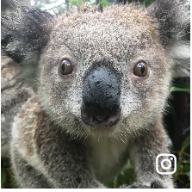
Scientific Naming
CFU 1
A scientific name is a name that describes the appearance of an organism or where it was first discovered.
A binomial system is used by scientists to name specific organisms.
A binomial name has two parts.
How do scientists name organisms?
CFU 2
Why is the common name “koala” NOT an example of a scientific name?
Genus species
Example of a scientific name:
Phascolarctos cinereus
Common name:
Koala
Vocabulary
Genus and species are names of categories in scientific naming.
Notes:
Teacher Cue – read through slide, breaking down the ‘bi’ (as in bicycle, biathlon etc.) meaning two. Have students take notes if desired.
Vocabulary – refer to the vocabulary box and explanation of ‘genus’ & ‘species’ when you encounter these terms.
CFU – have students pair share their answers, then call on non-volunteers.

Slide 9
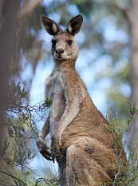
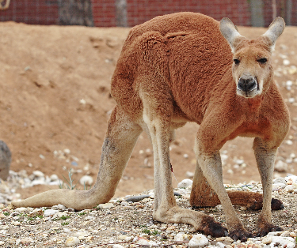
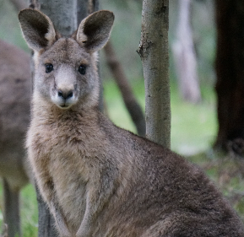
Scientific Naming
A scientific name also tells us the relationship between organisms.
is the category that groups organisms with common features.
Macropus: Kangaroos Wallabies
Wallaroos Tree-kangaroos
Genus
Species
is the most specific category and distinguishes the organism from others that are part of the same genus.
Species names are unique.
Macropus giganteus
Macropus rufus
Macropus fuliginosus
Notes:
Teacher Cue – read through slide, highlighting how the ‘Genus’ is like the last name / family name they all share (even though it goes first), and the species is like their first name – what makes them unique. Emphasise that we show that kangaroos, wallaroos, wallabies and tree-kangaroos are all closely related by using the same Genus (macropus) for them all, but different species names to identify their differences.
CFU – point to each of the kangaroo pictures and ask non-volunteers to tell you the Genus or species of that animal. Explain the ”trick” that the Genus is always capitalised (and comes first) and the species is not (and comes second).
Teacher Cue - Have students add to their notes if desired.

Slide 10
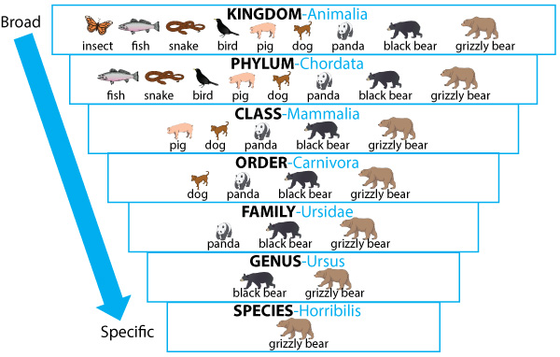

Scientific Naming
CFU
Which is the correct scientific name for a black bear?
Ursus horribilis
Ursus americanus
americanus
A scientific name has two parts: Genus and species
and tells us the relationship between organisms.
Eg.
Grizzly bear
Genus: Ursus
Species: horribilis
Scientific name: = Ursus horribilis
The Steps:
Identify the Genus and species
Write the Genus name first with a capital letter
Write the species name second with a lower case letter
Underline both words
SPECIES -americanus
Notes:
Teacher Cue – read through the slide including ’The Steps’ – thinking aloud and showing where in the diagram to look for the information about Genus and species.
CFU – prompt students to look at the added pink text on the side of the diagram, and have them pair-share and write their answers on whiteboards.

Slide 11
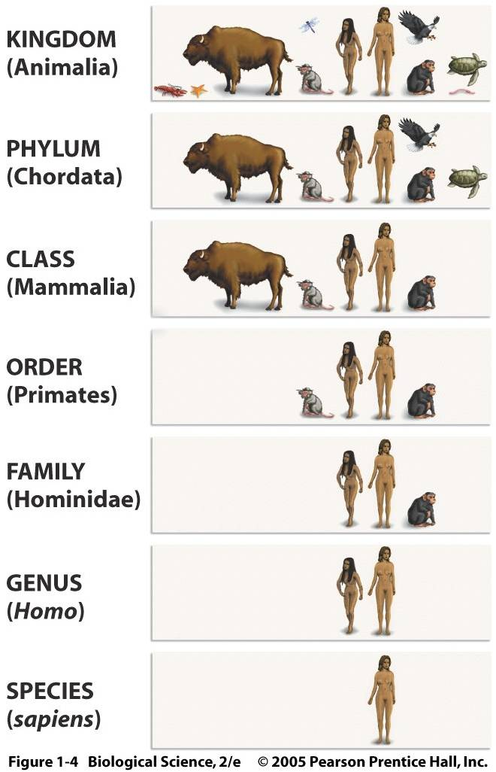
Scientific Naming
CFU
Which is the correct scientific name for a human?
Homo
Homo sapiens
Wise man
Be prepared to give a reason for your answer.
A scientific name has two parts: Genus and species
and tells us the relationship between organisms.
The Steps:
Identify the Genus and species
Write the Genus name first with a capital letter
Write the species name second with a lower case letter
Underline both words
This is a good box to remind yourself to do something. Such as get them to write their answer on their whiteboard.
Notes:
Teacher Cue – again, think aloud about how the number of organisms (living things) gets smaller and smaller with each level of categorisation, meaning that the things left at the levels of Genus and species are closely related.
Check for Understanding – students to pair/share, write answers on whiteboards. Use a class cue to check all student responses – prompt the class to check their own work for correct capitals etc. Call on (successful) non-volunteers to share and justify their answers. Encourage those with errors to fix them on their whiteboards
Hints

Slide 12
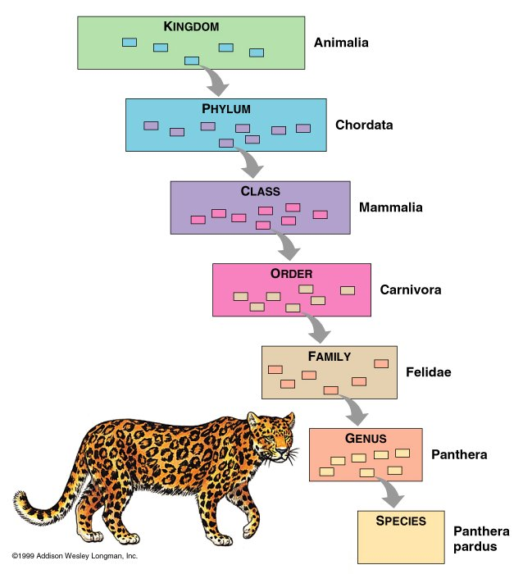
Scientific Naming
CFU 1
What is the name of the Genus the leopard is grouped in?
A scientific name has two parts: Genus and species
and tells us the relationship between organisms.
CFU 2
What is the scientific name of a leopard?
The Steps:
Identify the Genus and species
Write the Genus name first with a capital letter
Write the species name second with a lower case letter
Underline both words
This is a good box to remind yourself to do something. Such as get them to write their answer on their whiteboard.
Panthera
Fun fact
Panthera means leopard. pardus means spotted.
pardus
Notes:
Check for Understanding – students to pair/share, write answers on whiteboards. Use a class cue to check all student responses – prompt the class to check their own work for correct capitals etc. Call on (successful) non-volunteers to share and justify their answers. Encourage those with errors to fix them on their whiteboards.

Slide 13
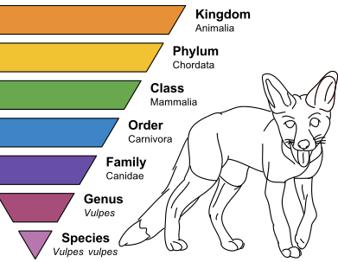
Scientific Naming
A scientific name has two parts: Genus and species
and tells us the relationship between organisms.
CFU 2
What is the scientific name of a fox?
The Steps:
Identify the Genus and species
Write the Genus name first with a capital letter
Write the species name second with a lower case letter
Underline both words
This is a good box to remind yourself to do something. Such as get them to write their answer on their whiteboard.
Notes:
Check for Understanding – students to pair/share, write answers on whiteboards. Use a class cue to check all student responses – prompt the class to check their own work for correct capitals etc. Call on (successful) non-volunteers to share and justify their answers. Encourage those with errors to fix them on their whiteboards. Answer = Vulpes vulpes (Explain that there are a number of animals with repeated names like this, such as Rattus rattus (common name = black rat).

Slide 14
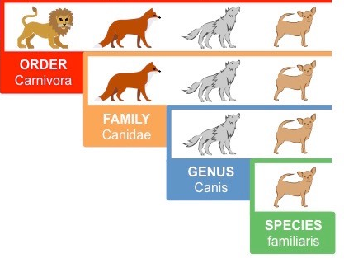
Scientific Naming
A scientific name has two parts: Genus and species
and tells us the relationship between organisms.
CFU 1
What is the name of the Genus that dogs belong to?
The Steps:
Identify the Genus and species
Write the Genus name first with a capital letter
Write the species name second with a lower case letter
Underline both words
This is a good box to remind yourself to do something. Such as get them to write their answer on their whiteboard.
Fun fact
Familiaris is a Latin word for ‘household’.
Notes:
Check for Understanding – students to pair/share, write answers on whiteboards. Use a class cue to check all student responses – prompt the class to check their own work for correct capitals etc. Call on (successful) non-volunteers to share and justify their answers. Encourage those with errors to fix them on their whiteboards.

Slide 15
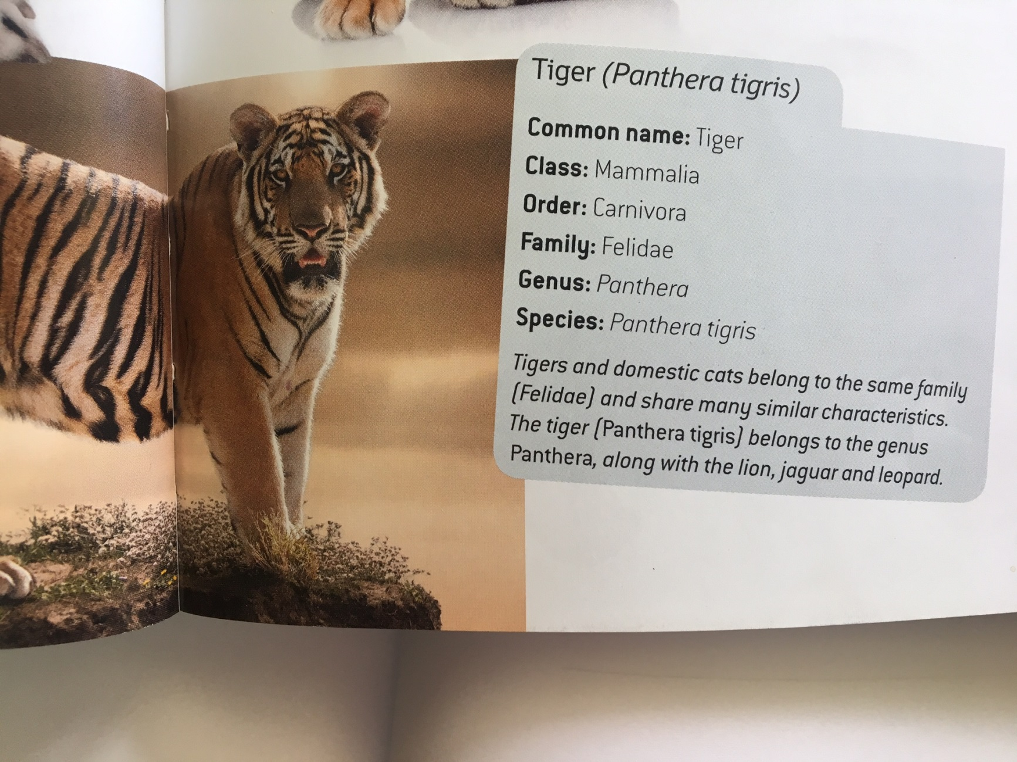
Scientific Naming
A scientific name has two parts: Genus and species
and tells us the relationship between organisms.
CFU 1
What is the scientific name for this animal?
Panthera
tigris
The Steps:
Identify the Genus and species
Write the Genus name first with a capital letter
Write the species name second with a lower case letter
Underline both words
This is a good box to remind yourself to do something. Such as get them to write their answer on their whiteboard.
Canis
Notes:
Check for Understanding – students to write their answers on whiteboards. Use a class cue to check all student responses – prompt the class to check their own work for correct capitals etc. Call on (successful) non-volunteers to share and justify their answers. Encourage those with errors to fix them on their whiteboards.

Slide 16
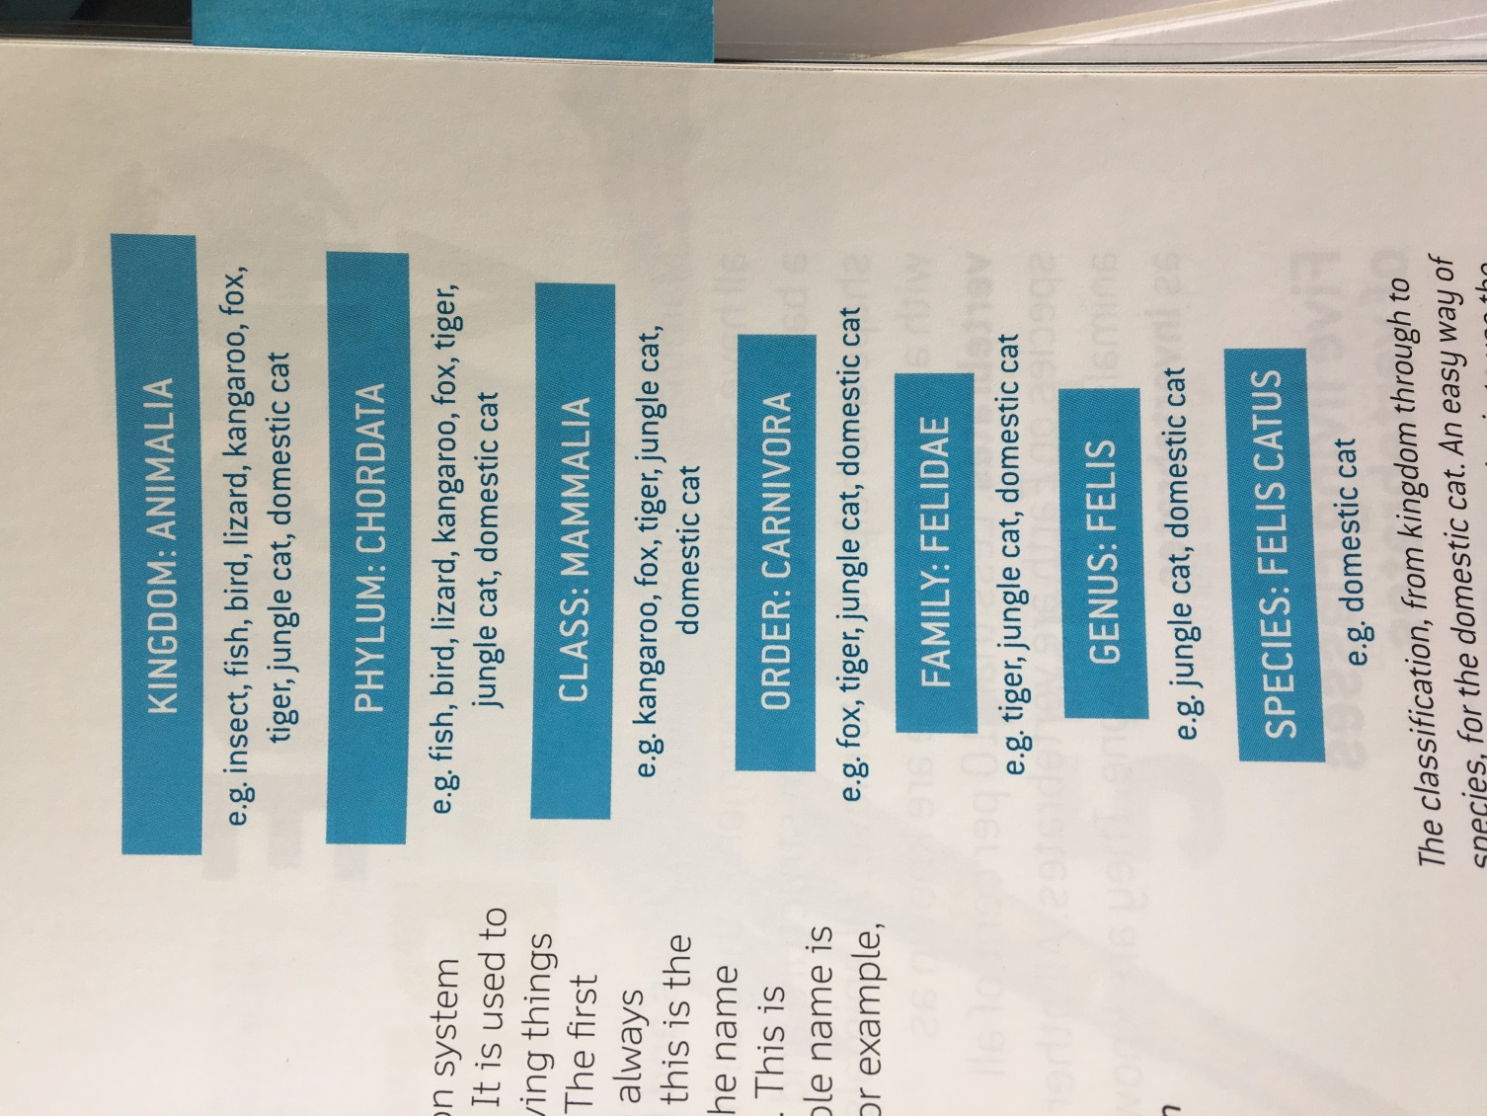
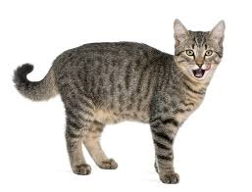
Scientific Naming
A scientific name has two parts: Genus and species
and tells us the relationship between organisms.
CFU 1
What is the scientific name for a domestic (house) cat?
The Steps:
Identify the Genus and species
Write the Genus name first with a capital letter
Write the species name second with a lower case letter
Underline both words
This is a good box to remind yourself to do something. Such as get them to write their answer on their whiteboard.
Notes:
Check for Understanding – students to write their answers on whiteboards. Use a class cue to check all student responses – prompt the class to check their own work for correct capitals etc. Call on (successful) non-volunteers to share and justify their answers. Encourage those with errors to fix them on their whiteboards.

Slide 17
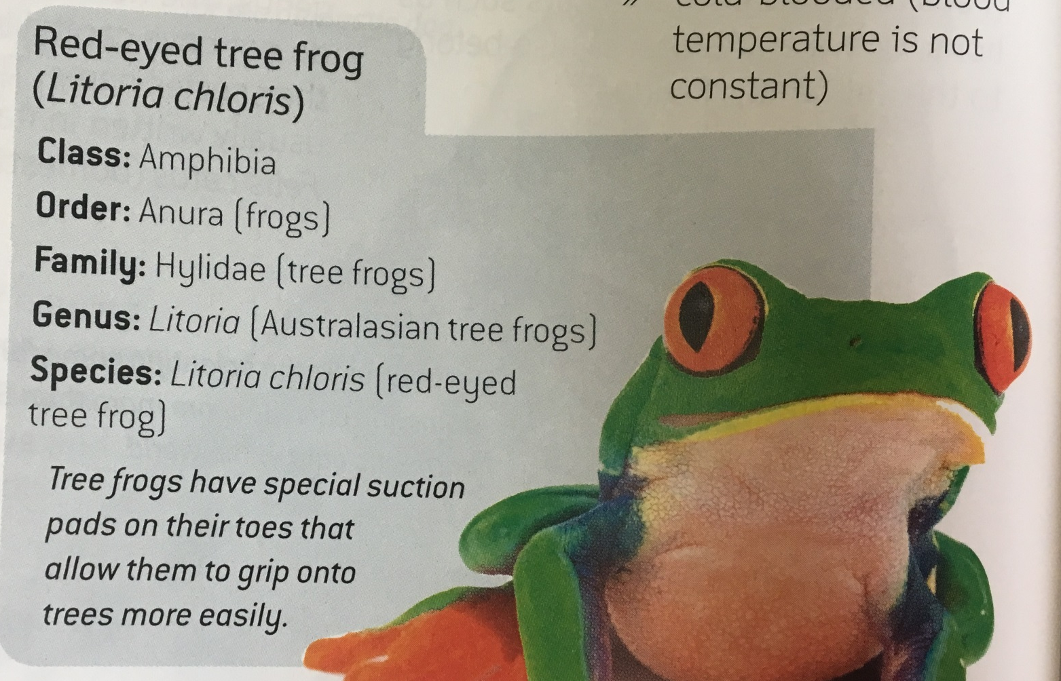
Scientific Naming
A scientific name has two parts: Genus and species
and tells us the relationship between organisms.
CFU 1
What is the scientific name for this frog?
The Steps:
chloris
Identify the Genus and species
Write the Genus name first with a capital letter
Write the species name second with a lower case letter
Underline both words
This is a good box to remind yourself to do something. Such as get them to write their answer on their whiteboard.
Notes:
Check for Understanding – students to write their answers on whiteboards. Use a class cue to check all student responses – prompt the class to check their own work for correct capitals etc. Call on (successful) non-volunteers to share and justify their answers. Encourage those with errors to fix them on their whiteboards.

Slide 18
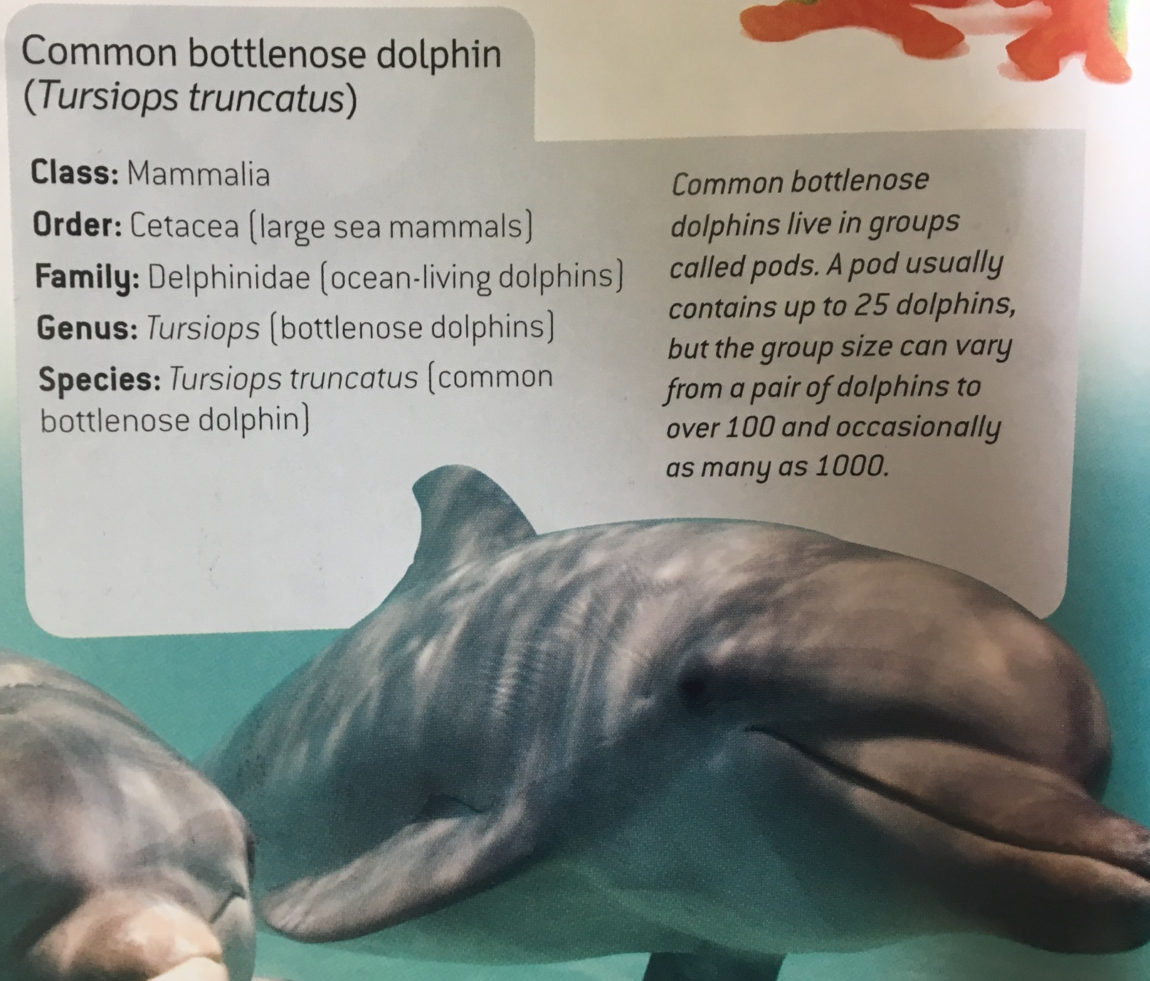
Scientific Naming
A scientific name has two parts: Genus and species
and tells us the relationship between organisms.
CFU 1
truncatus
What is the scientific name for this organism?
The Steps:
Identify the Genus and species
Write the Genus name first with a capital letter
Write the species name second with a lower case letter
Underline both words
This is a good box to remind yourself to do something. Such as get them to write their answer on their whiteboard.
Notes:
Check for Understanding – students to write their answers on whiteboards. Use a class cue to check all student responses – prompt the class to check their own work for correct capitals etc. Call on (successful) non-volunteers to share and justify their answers. Encourage those with errors to fix them on their whiteboards.

Slide 19
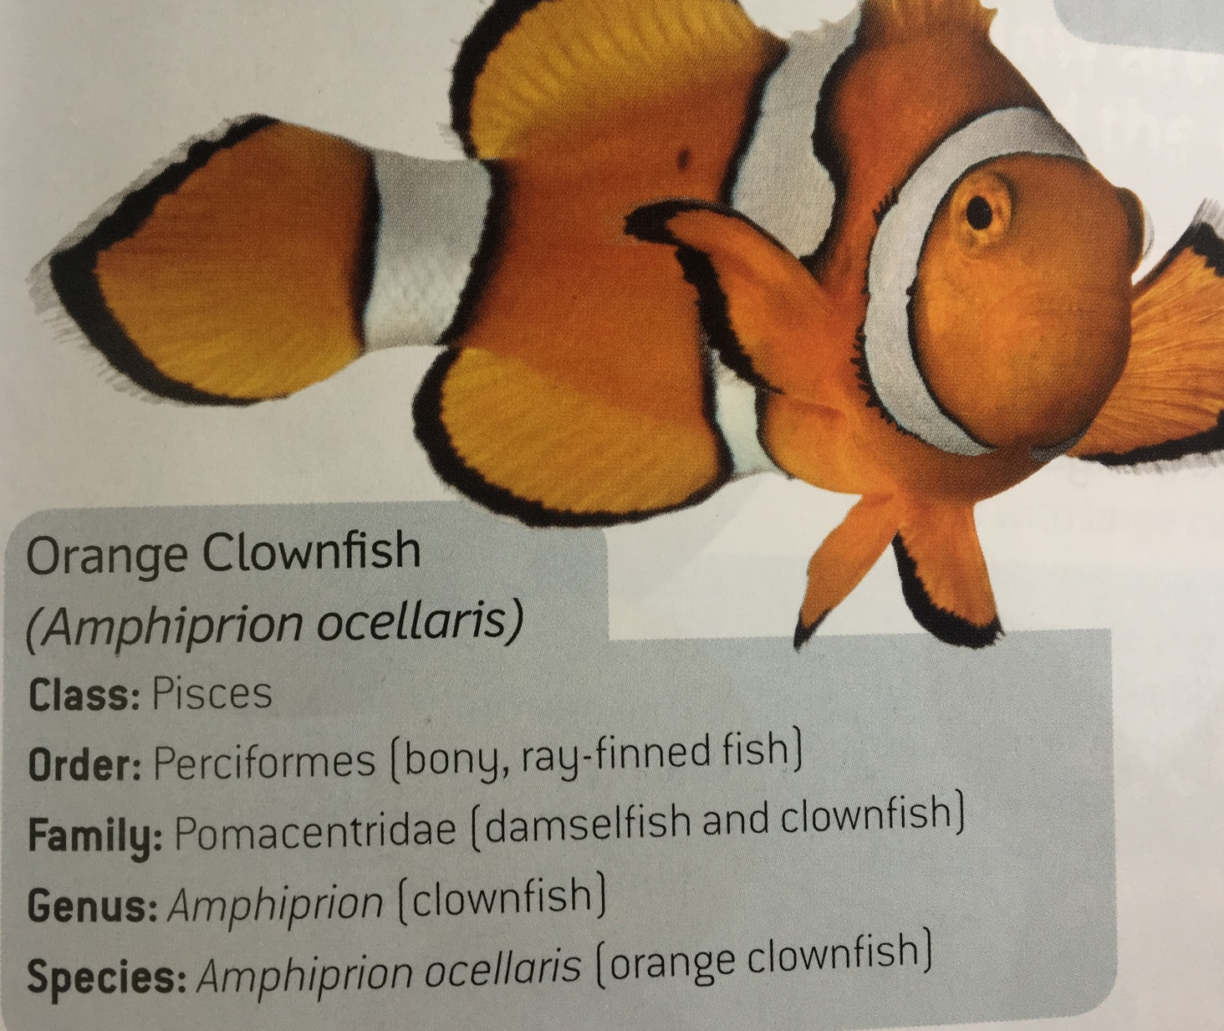
Scientific Naming
A scientific name has two parts: Genus and species
and tells us the relationship between organisms.
CFU 1
What is the scientific name for this organism?
The Steps:
Identify the Genus and species
Write the Genus name first with a capital letter
Write the species name second with a lower case letter
Underline both words
This is a good box to remind yourself to do something. Such as get them to write their answer on their whiteboard.
ocellaris
Notes:
Check for Understanding – students to write their answers on whiteboards. Use a class cue to check all student responses – prompt the class to check their own work for correct capitals etc. Call on (successful) non-volunteers to share and justify their answers. Encourage those with errors to fix them on their whiteboards.

Slide 20
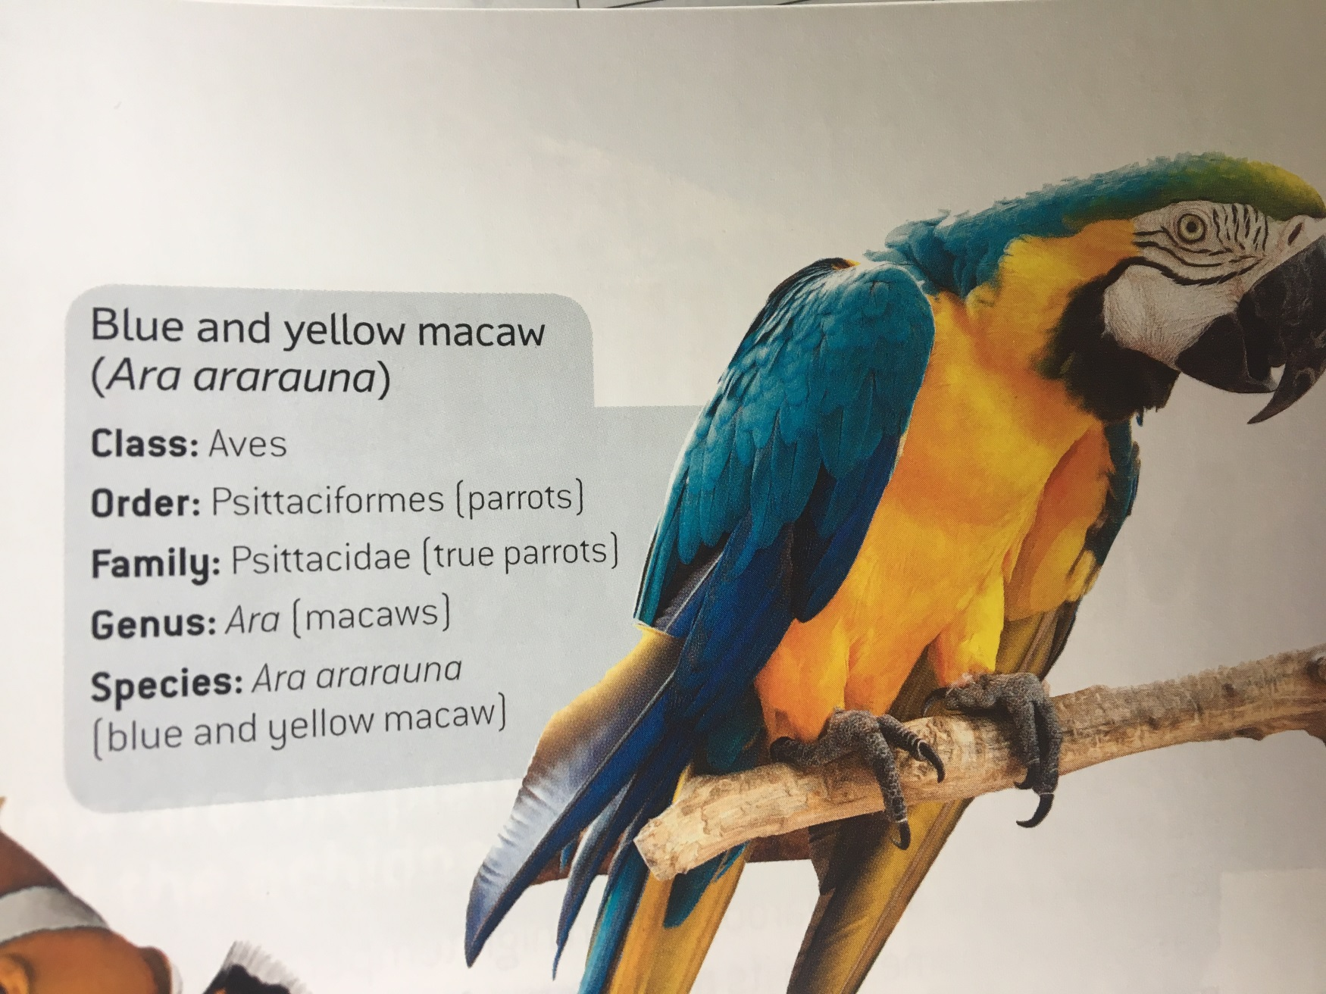
Scientific Naming
A scientific name has two parts: Genus and species
and tells us the relationship between organisms.
CFU 1
What is the scientific name for this organism?
The Steps:
Identify the Genus and species
Write the Genus name first with a capital letter
Write the species name second with a lower case letter
Underline both words
This is a good box to remind yourself to do something. Such as get them to write their answer on their whiteboard.
ararauna
Notes:
Check for Understanding – students to write their answers on whiteboards. Use a class cue to check all student responses – prompt the class to check their own work for correct capitals etc. Call on (successful) non-volunteers to share and justify their answers. Encourage those with errors to fix them on their whiteboards.

Slide 21
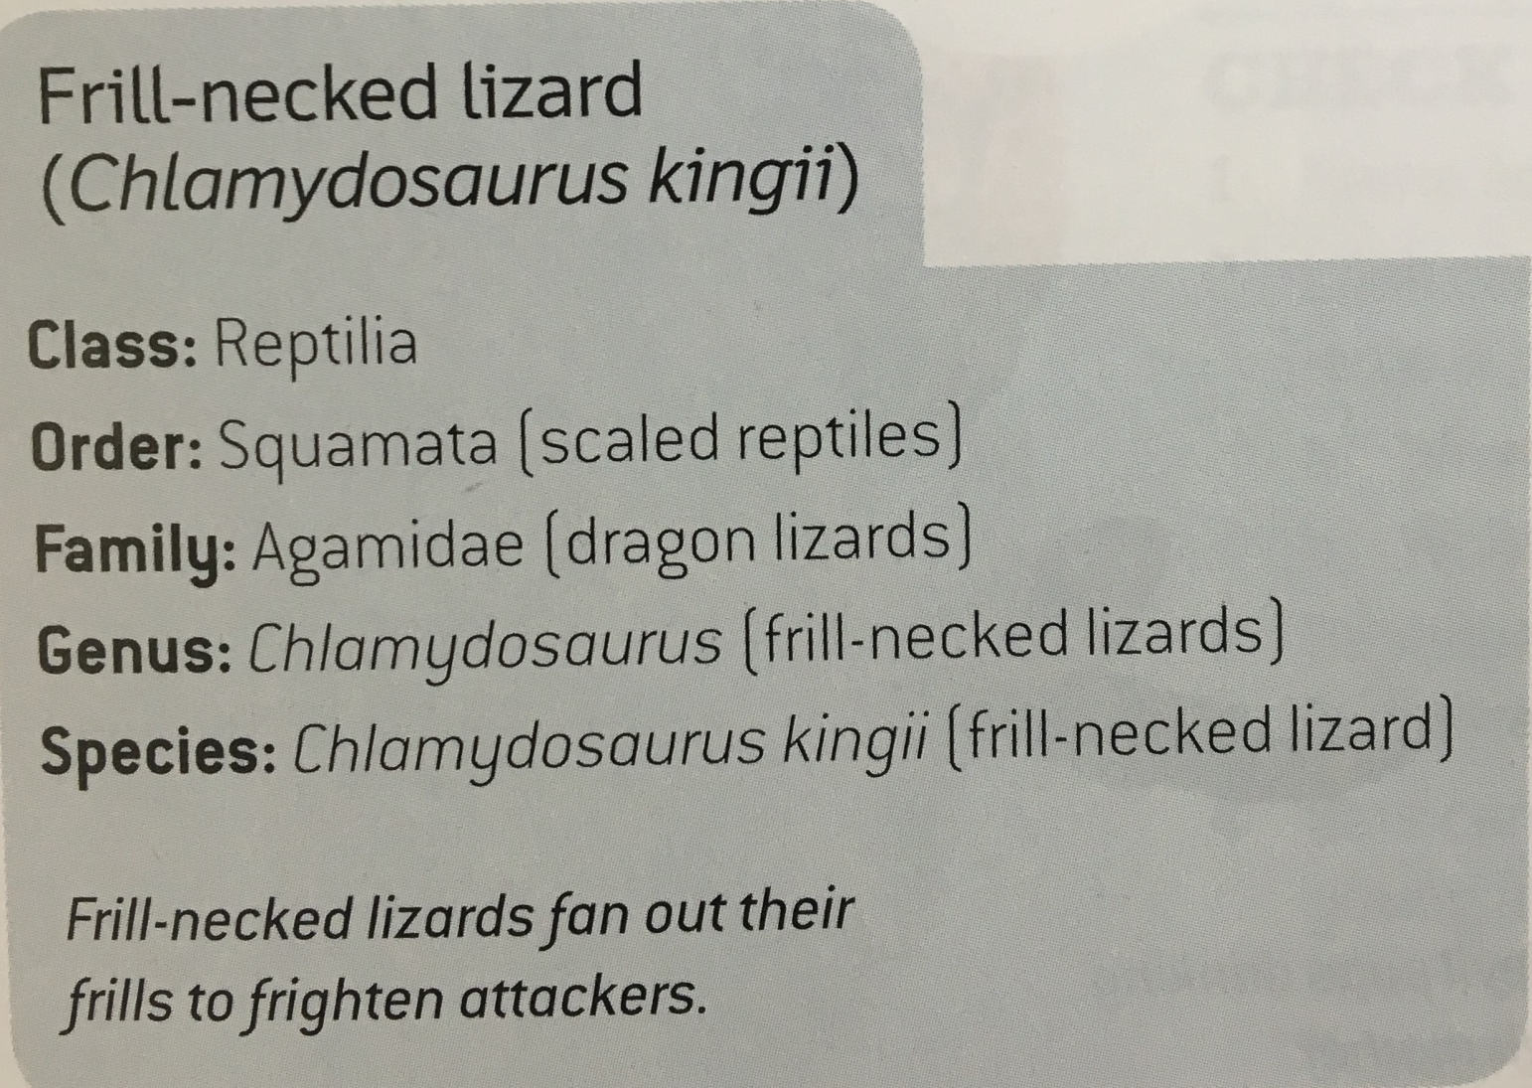
Scientific Naming
A scientific name has two parts: Genus and species
and tells us the relationship between organisms.
CFU 1
What is the scientific name for this organism?
The Steps:
Identify the Genus and species
Write the Genus name first with a capital letter
Write the species name second with a lower case letter
Underline both words
kingii
This is a good box to remind yourself to do something. Such as get them to write their answer on their whiteboard.
Notes:
Check for Understanding – students to write their answers on whiteboards. Use a class cue to check all student responses – prompt the class to check their own work for correct capitals etc. Call on (successful) non-volunteers to share and justify their answers. Encourage those with errors to fix them on their whiteboards.

Slide 22
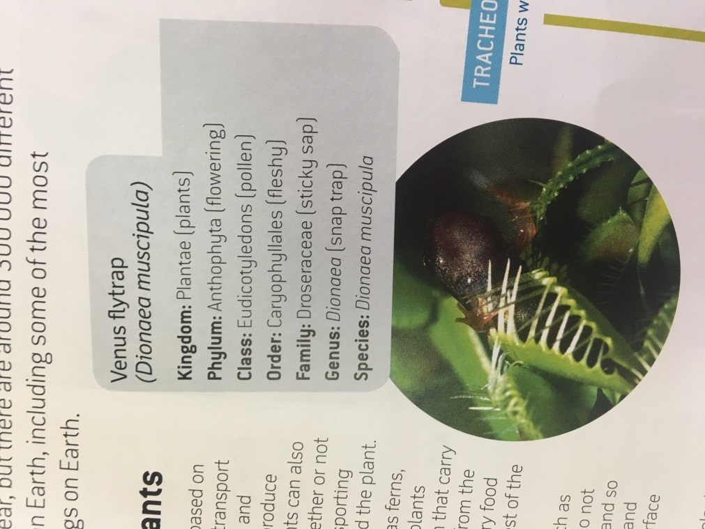

Scientific Naming
A scientific name has two parts: Genus and species
and tells us the relationship between organisms.
CFU 1
What is the scientific name for this organism?
The Steps:
Identify the Genus and species
Write the Genus name first with a capital letter
Write the species name second with a lower case letter
Underline both words
This is a good box to remind yourself to do something. Such as get them to write their answer on their whiteboard.
muscipula
Notes:
Teacher cue – clarify that the process of scientific naming is exactly the same for plants as animals.
Check for Understanding – students to write their answers on whiteboards. Use a class cue to check all student responses – prompt the class to check their own work for correct capitals etc. Call on (successful) non-volunteers to share and justify their answers. Encourage those with errors to fix them on their whiteboards.

Slide 23
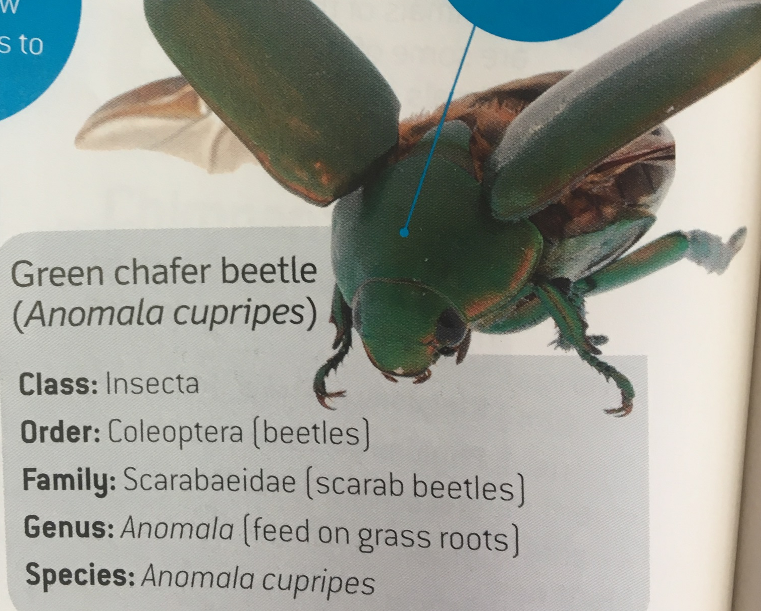
Scientific Naming
A scientific name has two parts: Genus and species
and tells us the relationship between organisms.
CFU 1
What is the scientific name for this organism?
The Steps:
Identify the Genus and species
Write the Genus name first with a capital letter
Write the species name second with a lower case letter
Underline both words
This is a good box to remind yourself to do something. Such as get them to write their answer on their whiteboard.
cupripes
Notes:
Check for Understanding – students to write their answers on whiteboards. Use a class cue to check all student responses – prompt the class to check their own work for correct capitals etc. Call on (successful) non-volunteers to share and justify their answers. Encourage those with errors to fix them on their whiteboards.

Slide 24
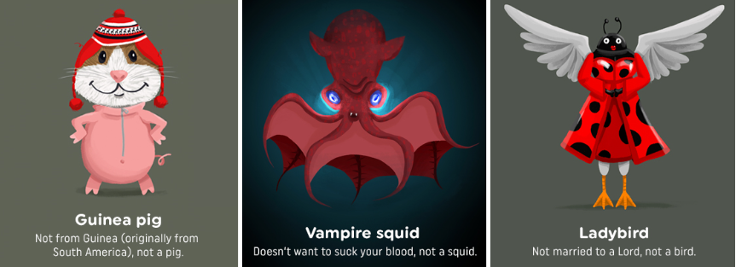
Why do we need to know about scientific naming?
Organisms are scientifically named so that it is easier to communicate.
If there is one common system, people all around the world will know exactly what animal or plant you refer to. It helps us to accurately describe organisms.
CFU
Can you think of a situation or place you have heard or seen a scientific name used?
Knowing about scientific naming comes in handy in a wide range of activities and jobs, from biologists and zoologists, to gardeners and tour guides - pretty much anyone working with or interested in living things!
Notes:
Check for Understanding – open the floor to volunteers for this CFU.

Slide 25
Which of these species are more closely related?
How can you tell?
CFU
Macropus irma Macropus robustus Vombatus ursinus
Be ready to explain your answer.
Notes:
CFU – Pair/share, call on non-volunteers. Ensure use of full sentence answers with science terminology.

Slide 26

Write the scientific names for these organisms:
CFU
1.
2.
Be ready to explain your answer.
giganteum
kingii
Notes:
Teacher Cue – ensure students complete this task independently (on whiteboards), then use a class cue (eg. ‘3-2-1 chin-it’) to evaluate success.

Slide 27
Students will use scientific names to identify species.
Notes:
Ask for a show of confidence (either thumbs up/middle/down or 5 finger rating) in students’ individual ability to achieve the learning objectives. Identify those who feel they need additional support / re-teaching.

Slide 28

Your turn: Scientific Names Hunt
The Steps:
Research 5 different examples of animals and plants.
Find their common and scientific names and record your findings in the table below.
Identify the Genus and species
Write the Genus name first with a capital letter
Write the species name second with a lower case letter
Underline both words
Common name | Scientific name
e.g. common starfish | Asterias rubens
Notes:
Teacher cue – have a range of animal ’fact file’ type print outs prepared and dispersed around the room. Have students rule up a table in their books, then go on a hunt for at least 10 from around the room.
Alternatively, have students list the common names of 10 organisms (you may wish to introduce a rule of including at least 2 plant species), then research online to find the scientific names of each.

